Slide 1
Object Relational Persistence

Slide 2
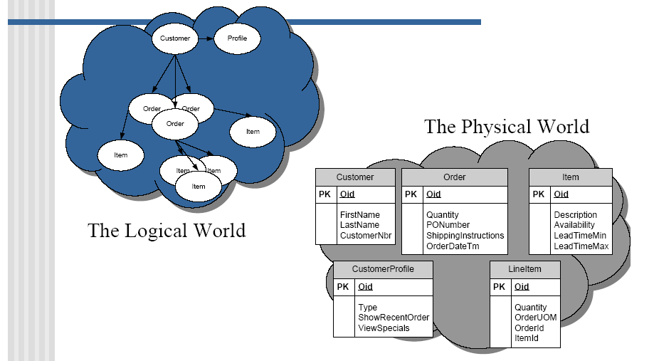
The Mismatch

Slide 3
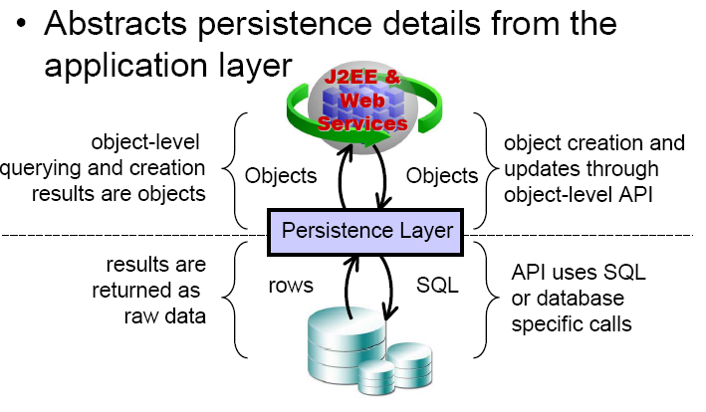
Persistance Layer

Slide 4
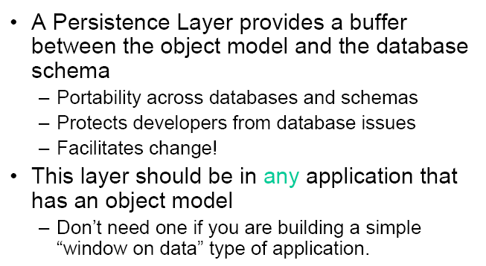
Benefits

Slide 5
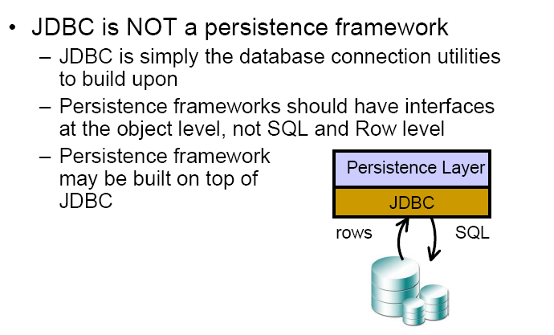
JDBC is it enough ?

Slide 6
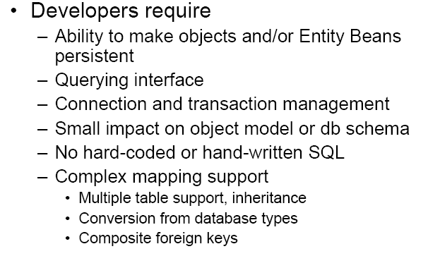
Persistence Layer requirements

Slide 7
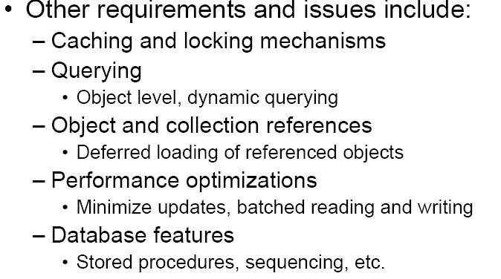
Continued

Slide 8
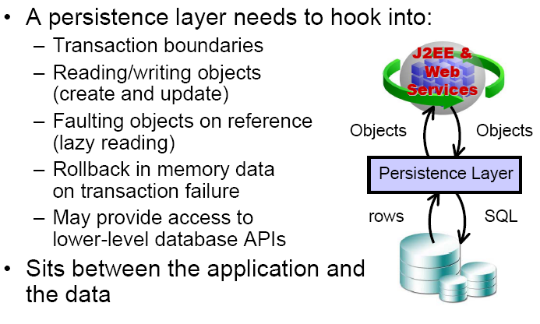
Where does it fit

Slide 9
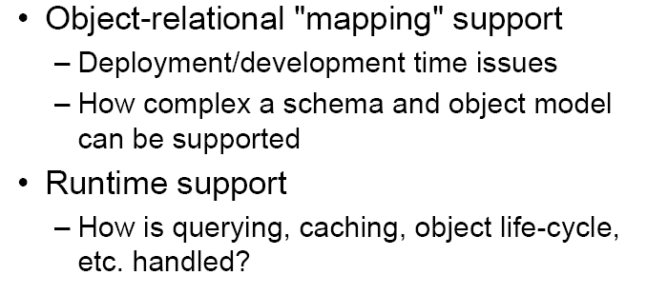
Persistence Layer two aspects

Slide 10
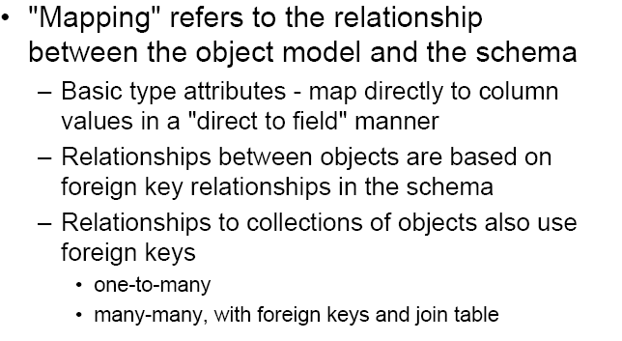
Mapping Objects

Slide 11
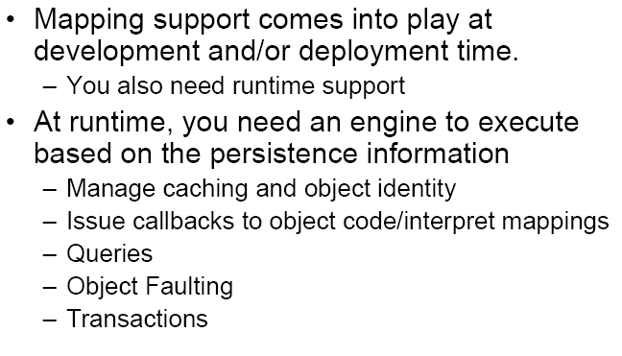
Runtime Support

Slide 12
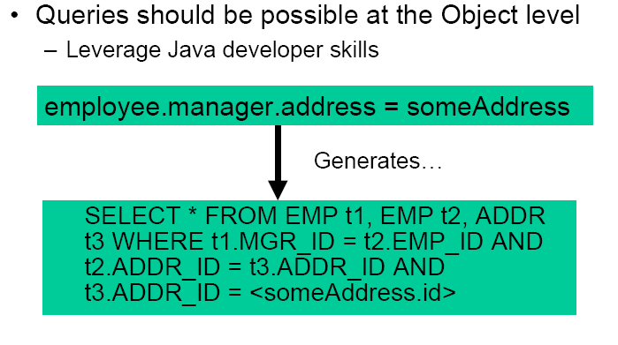
Querying

Slide 13
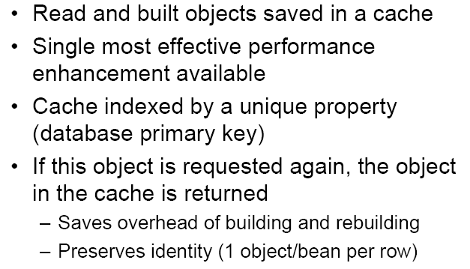
Caching

Slide 14
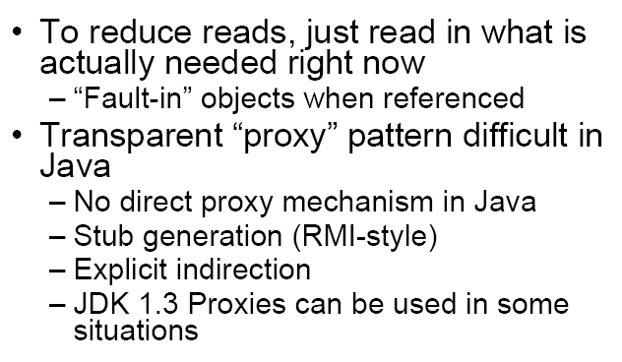
Just in time reading

Slide 15
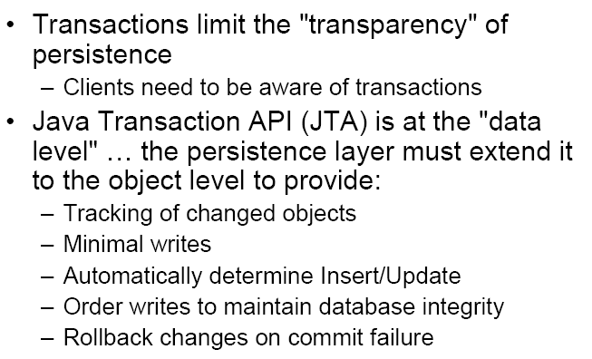
Transactions

Slide 16
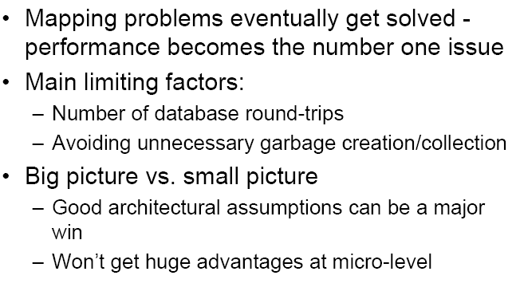
Performance

Slide 17
Hibernate
Opensource (LGPL)
Mature
Popular (13 000 downloads/month)
Custom API
Will be core of JBoss CMP 2.0 engine

Slide 18
Hibernate
Persistence for JavaBeans
Support for very fine-grained, richly typed object models
Powerful queries
Support for detached persistent objects

